Slide 1
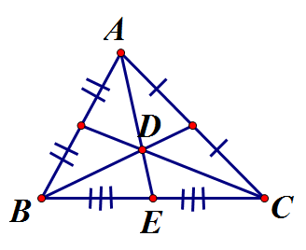
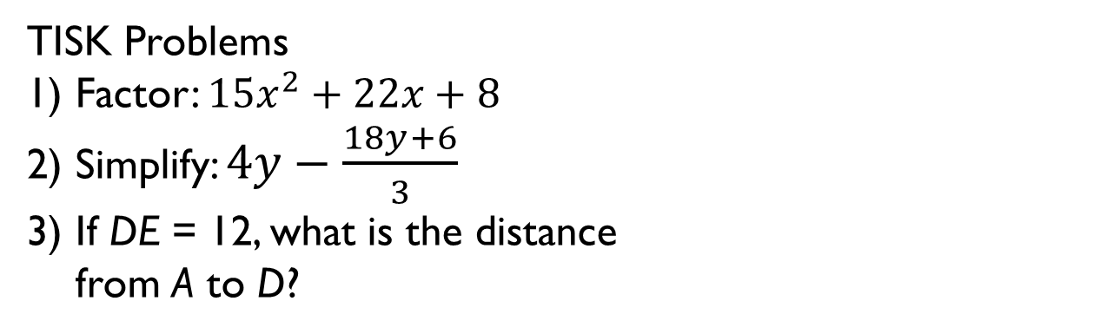
Monday, November 19, 2012
Agenda:
TISK Problems & 2 MM
Homework Check/Discuss
Lesson 6-3: Rectangles
Homework: Finish packet (due 11/27)
TISK Problems
Factor: $15x^{2}+22x+8$
Simplify: $4y−\frac{18y+6}{3}$
If DE = 12, what is the distance
from A to D?
Notes:
Mental Math
1.) Start with 40 more than twice the number of cookies in a dozen. Divide by the number of suits in a deck of cards. Square it. Subtract the number of years in a century. Add half the number of years in a decade. (161)
2.) Start with 30 less than the number of inches in a foot. Divide by half a dozen. Multiply by 7. Add the number of minutes in an hour. Add the number of years in a decade. Take the negative square root. (-7)

Slide 2
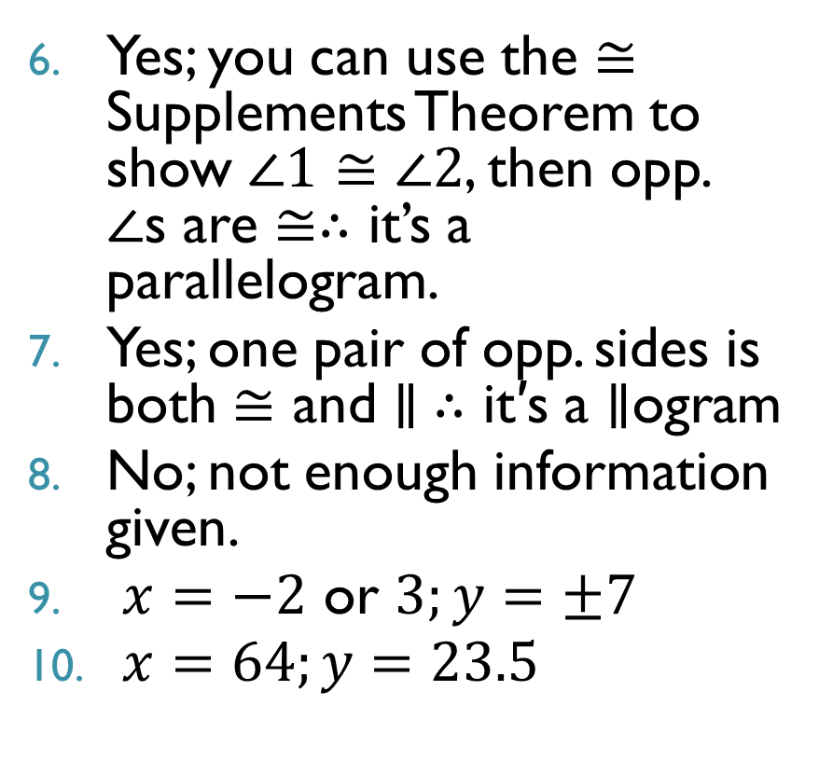
Homework Check
Yes; you can use the $≅$ Supplements Theorem to show $∠1≅∠2$, then opp. $∠$s are $≅∴$ it’s a parallelogram.
Yes; one pair of opp. sides is both $≅$ and $∥ ∴$ it′s a $∥$ogram
No; not enough information given.
$x=−2$ or $3;y=±7$
$x=64;y=23.5$
1
2

Slide 3
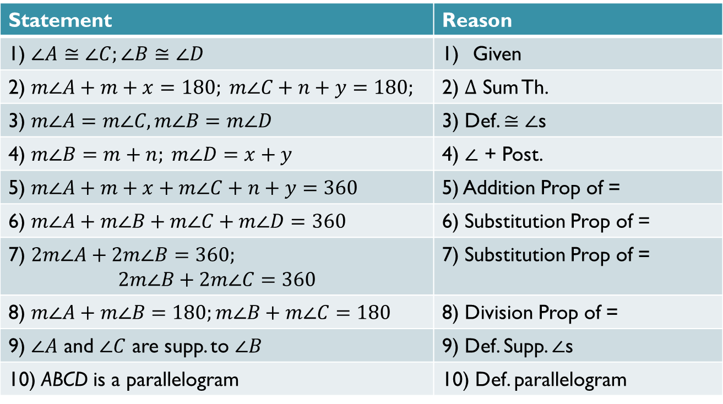
Homework Check
Statement | Reason
1) $∠A≅∠C;∠B≅∠D$ | Given
2) $m∠A+m+x=180; m∠C+n+y=180;$ | 2) $Δ$ Sum Th.
3) $m∠A=m∠C, m∠B=m∠D$ | 3) Def. $≅∠$s
4) $m∠B=m+n; m∠D=x+y$ | 4) $∠$ + Post.
5) $m∠A+m+x+m∠C+n+y=360$ | 5) Addition Prop of =
6) $m∠A+m∠B+m∠C+m∠D=360$ | 6) Substitution Prop of =
7) $2m∠A+2m∠B=360;$ $$2m∠B+2m∠C=360$$ | 7) Substitution Prop of =
8) $m∠A+m∠B=180;m∠B+m∠C=180$ | 8) Division Prop of =
9) $∠A$ and $∠C$ are supp. to $∠B$ | 9) Def. Supp. $∠$s
10) ABCD is a parallelogram | 10) Def. parallelogram
What did you come up with?

Slide 4
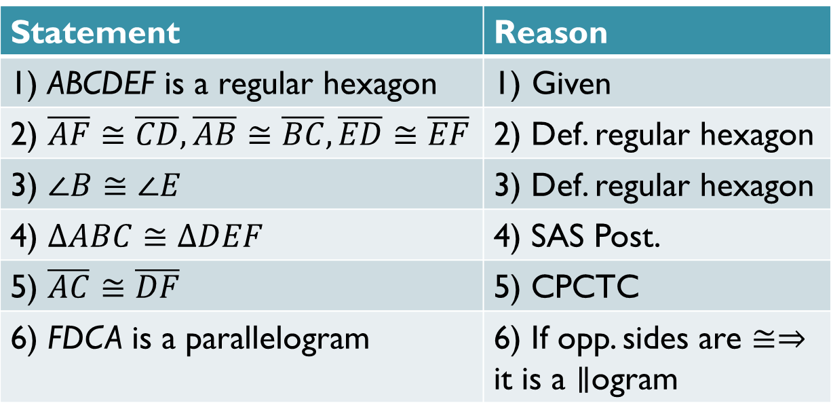
Homework Check
Statement | Reason
1) ABCDEF is a regular hexagon | Given
2) $\overline{AF}≅\overline{CD}, \overline{AB}≅\overline{BC}, \overline{ED}≅\overline{EF}$ | 2) Def. regular hexagon
3) $∠B≅∠E$ | 3) Def. regular hexagon
4) $ΔABC≅ΔDEF$ | 4) SAS Post.
5) $\overline{AC}≅\overline{DF}$ | 5) CPCTC
6) FDCA is a parallelogram | 6) If opp. sides are $≅⇒$ it is a $∥$ogram
What did you come up with?

Slide 5
§6.3 Rectangles
Definition
  Rectangle
    A parallelogram is a rectangle if and only if it has 4 congruent angles.

Slide 6
Example. Using rectangle properties.
right angles
90
90
84
6
12
7

Slide 7
Theorems
congruent

Slide 8
How do you check to see if a quadrilateral is a rectangle?
First check to see if it is a parallelogram:
  Opposite sides are parallel.
  Opposite sides are congruent.
  Opposite angles are congruent.
  Diagonals bisect each other.
  One pair of opposite sides are both congruent and parallel.
Then, check to see if it’s a rectangle.
  All 4 angles are right angles.
  Diagonals are congruent.

Slide 9
Example. Decide whether the statement is true or false. Explain your reasoning.
If a quadrilateral has opposite sides that are congruent, then it is a rectangle.
False; a quadrilateral with opposite sides congruent only proves it is a parallelogram, not necessarily a rectangle.

Slide 10
Example. Determine if the vertices form a rectangle.
A(-3, 1)
B(4, 8)
C(7, 5)
D(0, -2)

